Slide 1
Obama Speech Analysis
Sihan Wang
Notes:
In this project, I will use various NLP techniques to analyze the speech of Barack Obama during his two consecutive presidential terms from 2009 to 2017. The goal of this project is to gain insights into the major topics covered in the selected speeches, and investigate how external factors may influence the frequencies of different topics in Obama’s speech.

Slide 2
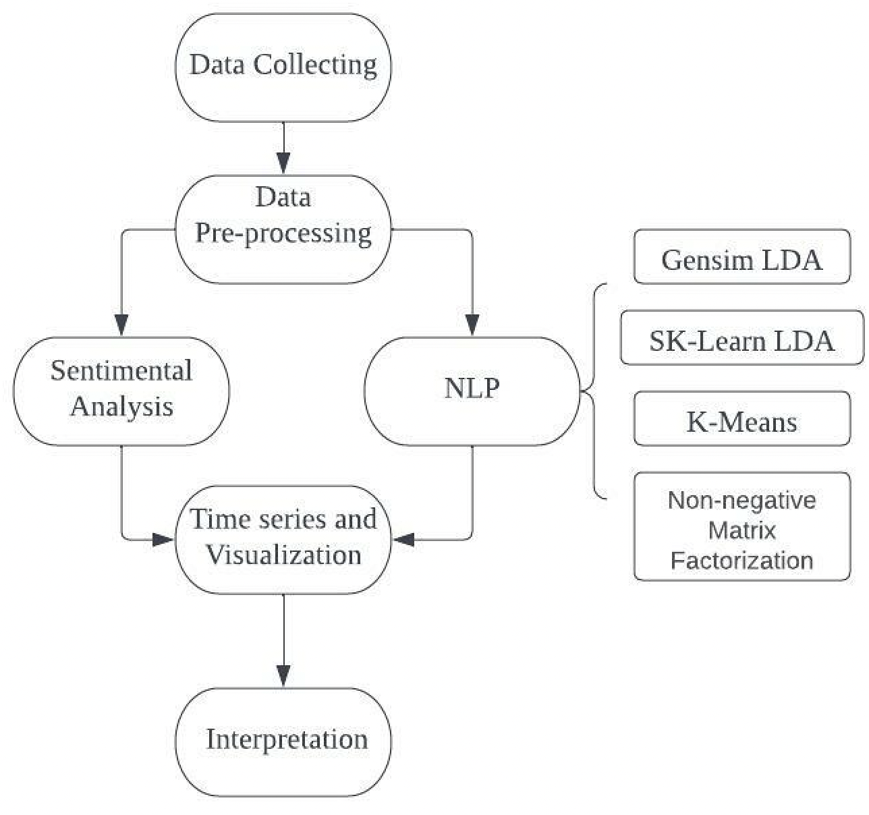
Speech analyzing procedures
Data collection
Data cleaning
NLP with different methods
Sentimental Analysis
Topic Modeling Visualization
Conclusion
Notes:
The flowchart below demonstrates the processes involved in my analysis. First, I fetch the speech texts from the website using beautifulSoup. Then we preprocessed the text data with various techniques such as stopword removal and lemmatization. After removing the redundancies in the original texts, we can start our further analysis.
In step 3, i use 4 methods to examine the topics in Obama’s speech. LDA in gensim, LDA in Sk-learn, K-means, and Non-nagative matric factorization to train the data , Then compare the results of these 4 models to determine the final topics.
Step 4 is to do Sentiment analysis is to discover whether Obama’s speech is more positive or negative or it’s neutral. Then in step 5, i visualize the result from NLP and sentiment analysis base on his presidential time. Base on step 5, I will interpret the plot and discuss how the external factors affect his speech time and amount.

Slide 3
Data Collecting and Pre-processing
Notes:
Now i’m going to talk about data collecting and pre-processing

Slide 4

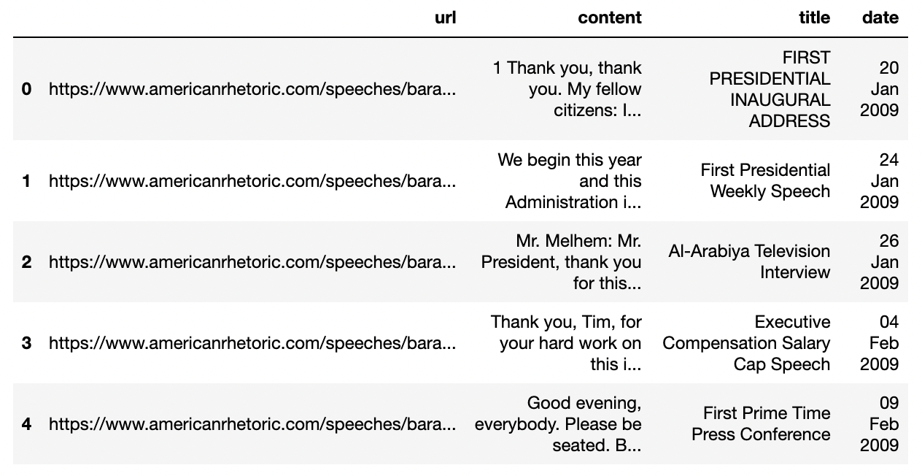
Data Collecting
BeautifulSoup to fetch the URL of each speech
BeautifulSoup to extract the title,
date, and content of each speech
Notes:
For the data collection process, we used the packages urllib and beautifulSoup to extract the web links and content for each speech.
In the first part, we go to the home page of the speech bank website, and use request() function to fetch the links of Obama's speeches. Since the link of speech is contained in ‘href’ tags, we apply html.parser() to find the all the links in 'href' tags, then save the information into a list. Next, we only keep the links start with ‘speeches’ and end with ‘htm’, and remove the duplicate ones. Then I add a prefix ‘www.americanrhetoric.com’ in front of each link to complete the speech link. In the white box, we can see the complete link format of each speech.
Secondly, I iterate every url to extract the titles, date and speech content, save them into a dataframe. The data frame screen shot describes our collected data, there are 4 columns, store the speech link, the speech content, title and date. Now we can use it in data pre-processing part.

Slide 5
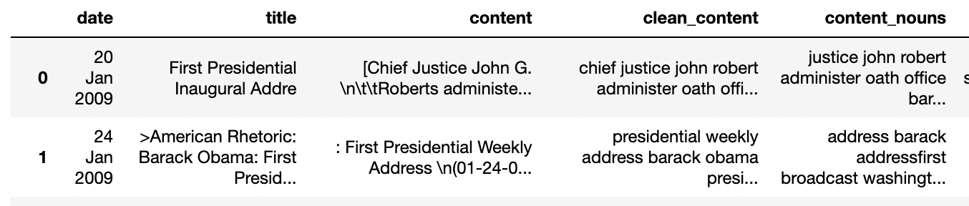
Data Pre-processing
Regular expression and nltk tokenizer
– Remove all punctuations, numbers, special characters, then lowercase
Stemmer
– Lower the inflation of words into root words by cutting the prefix and suffix
Word Lemmatizer
– Classify the nouns and verbs in the speeches
Notes:
In the data pre-processing step, I clean the text using a variety of NLTK techniques. I modified the text's case to lowercase, and get rid of all the punctuation , useless strings and characters use regular expression . next, by using stemmer i remove the suffix and prefix of each word, and transform the words to their root form. I then remov the unnecessary information by combining the package's stopword with other stop word extensions. The word is then converted back into its original lemma form for nouns and verbs using the wordNetLemmatizer. In order to train the model in the next step

Slide 6
NLP Topic Modelling
Notes:
Now we are in the topic modelling section and I will explain 4 methods i used in topic modeling.

Slide 7
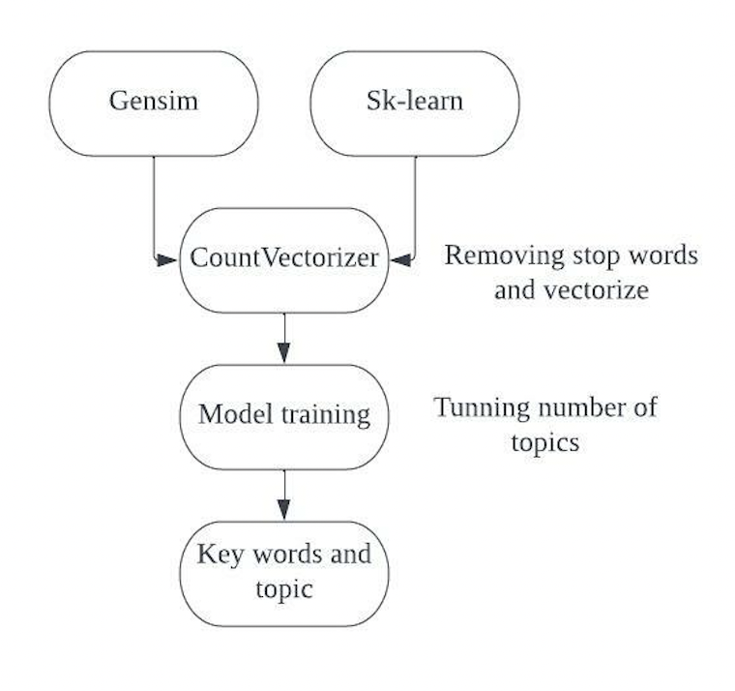
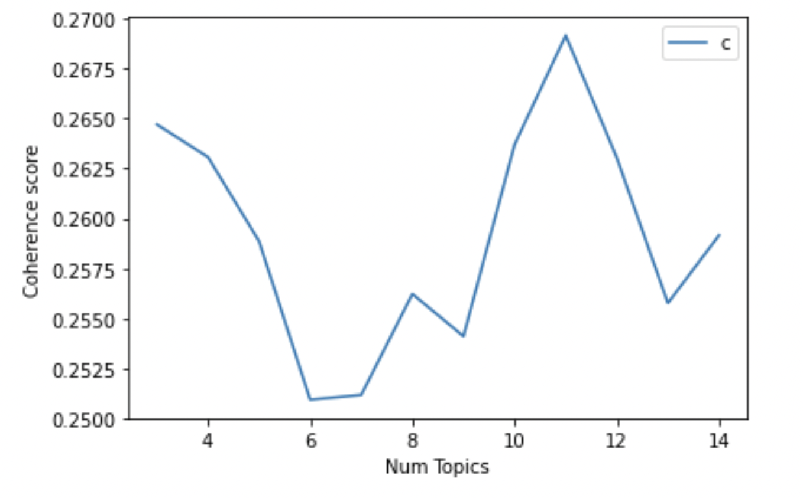
Models: Gensim and Sk-Learn
Model procedure Optimal topic number = 11
Notes:
The first two methods are Gensim and Sk-learn. The left graph shows how I process the model training steps. For both models, I use Countvectorizer with stop words dictionary to vectorize the content of the speeches. Next step is to tune the number of topic. the initial number of topic i choose to run the model is 15, since 15 may not be a suitable number, I compute the coherence score to find the optimal value. So how can we pick the optimal value, we select the value with highest coherence score. on the right side, is the plot from gensim model, since both gensim and sk-learn model give the same optimal value so i will use gensim plot to explain. we see that when number of topic equals 11, the coherence score is the highest. Thus 11 is my optimal number of topic. Then I use my new topic number to re-run the model to get the key words and conclude the topics.

Slide 8
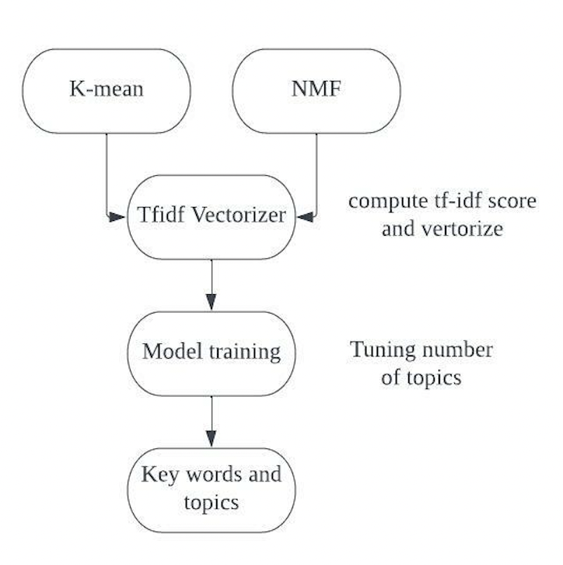
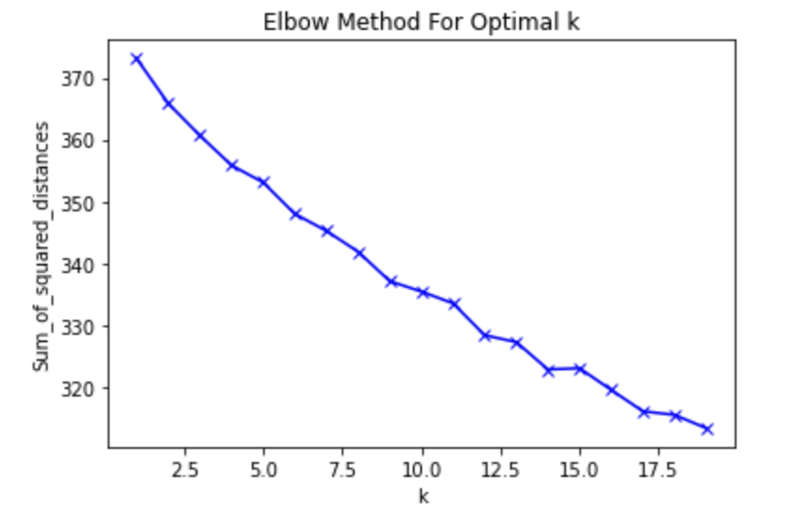
Models: K-mean and NMF
Model procedure Optimal topic number (no clear answer)
Notes:
The other two methods are K-means and NMF. The procedures are similar as Gensim model, but instead of using Countvectorizer, I use TF-IDF vectorizer in these 2 models. In the tunning part, I use elbow method for K-means and Coherence score for NMF model to find the optimal number of topic. However, both model do not show a clear answer. The right plot is the elbow method for K-means, the value drops smoothly, there is no big curve, so it’s hard to tell the optimal value. Then I decide to use 11 as optimal number of topic from gensim and sk-learn, to re-run these two models and perform the key words.

Slide 9
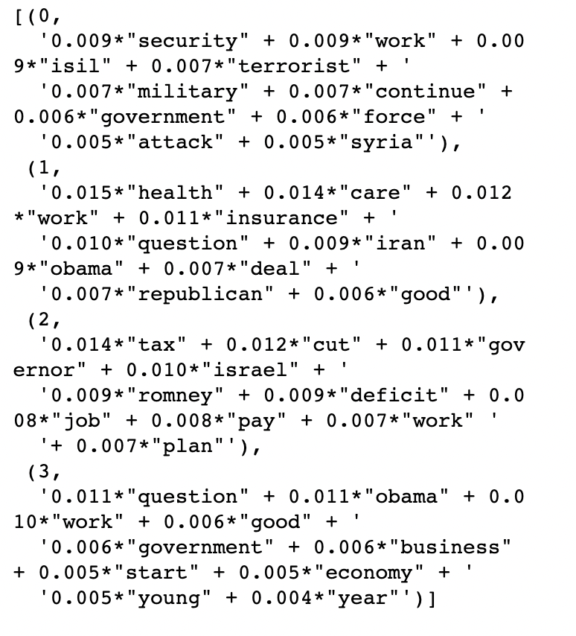
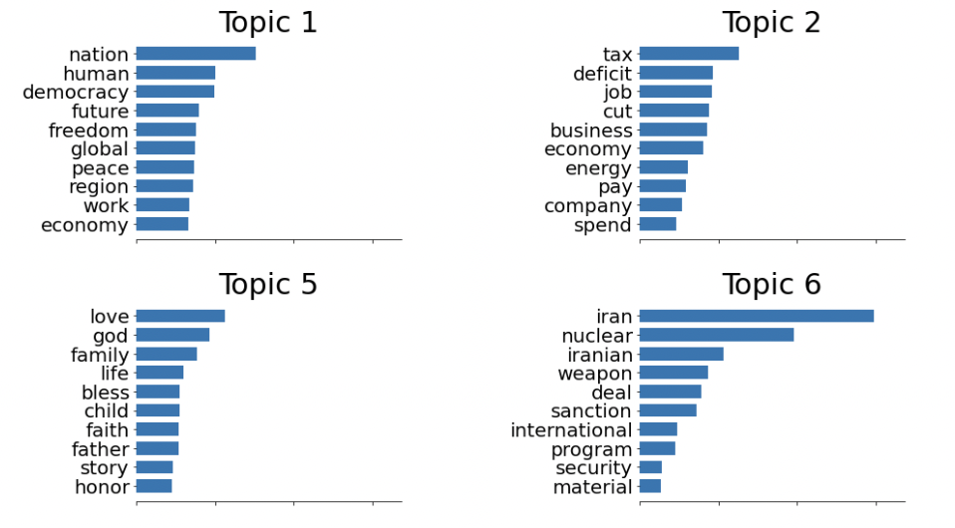
Result of topic modeling
Output of Gensim model Output of NMF model
Notes:
After rerunning the model, I compared the results of the 4 methods and found them to be very similar but the result from NMF is more clear than others. Here I would like to show the results of the gensim and nmf methods. The left figure shows the results of the first four topics of gensim, which are about security, health care, jobs and tax, and government. The right figure shows the results of nmf, which are about government and democracy, and Both graphs show the weight of each topic word in this topic. Later in the visualization I will discuss all the topics.

Slide 10
Sentiment Analysis
Notes:
Now im going to talk about the sentimen analysis. Whether obama’s speech is more negative, positive or neutral.

Slide 11
Sentiment analysis
Notes:
First, I talk about emotions into 5 categories, -0.75 or below is strong negative, -0.75 to -0.2 is negative, -0.2 to 0.2 is neutral, 0.2 to 0.75 is positive, and 0.75 or above is strong positive. Then I will classify all speeches into different sentiments, and same process for each topic.

Slide 12
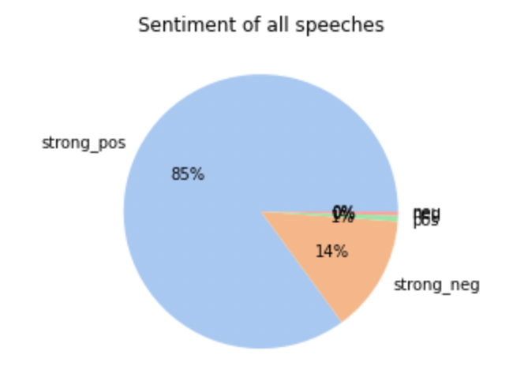
Overall Sentiments
Strong Positive: 364
Positive: 3
Neutral; 0
Negative: 2
Strong Negative: 59
Notes:
This pie chart shows us the number of speeches contained in different sentiments. It is easy to see that most of Obama's speeches are strong positive because 364 speeches are in this section, and he usually speaks with a very positive impact. Then there are 3 speeches that are positive, 59 speeches that are strong negative, and 2 speeches that are negative. There are no neutral tone speeches。 Next, let's look at which topics are strong positive and which are strong negative

Slide 13
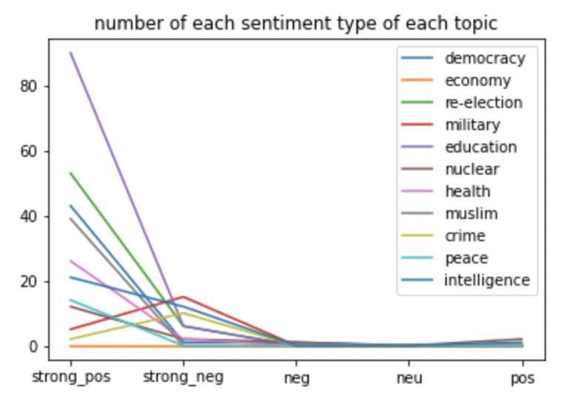
Sentiments for each topic
Most of the topics have more positive sentiment
Military topic has strongest negative sentiment compare to other topics
When talking about democracy, health care, labour, economy and education, Obama had more optimistic tone
Notes:
In this section I have categorized the speeches contained in each topic, and from the graph on the right we can understand that Most of the topics are more positive sentiment. But when Obama talks about military and crime, he‘s more negative。 When he talks about democracy, health care, labor, economy and education, Obama had more optimistic tone. When he talks about democracy, health care, labor, economy and education, Obama had more optimistic tone. Especially when he discusses topics related to education, he is in the most optimistic mood

Slide 14
Topic visualization
Notes:
Now let;s talk about the results of topic modelling and sentiment analysis.

Slide 15
Topics
Democracy and Human Rights Freedom
Economy and job opportunities
Obama’s second presidential election
Military force and threat to Muslims in Iraq, Isil etc.
Education and family
Nuclear war in Iran
Health Care issues
Criminal Law and violence
Intelligence security and surveillance
Notes:
Based on the four models that I have used previously, I came up with the following nine topics by comparing the results. The first one is related to democracy and human rights and freedoms, the second one is about economy, taxes and employment opportunities. The third is about Obama's second term, and the fourth is about children's education and family safety. The fifth is about Iran, Iraqi nuclear security, and the sixth is about the military and threats and force against Muslims and Israel. The seventh is about health care in the United States, the eighth is about criminal laws and violence, and the last discusses technological security and technological surveillance.

Slide 16
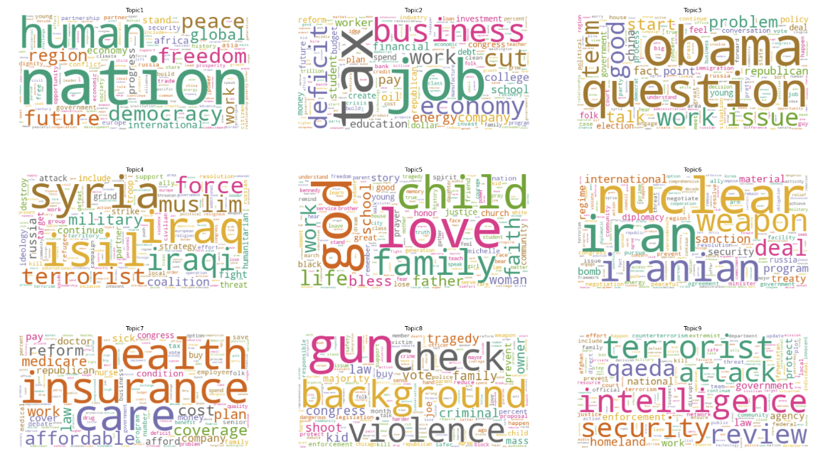
Notes:
These are the word clouds based on the nine topics, we can see in each word clouds has a clear topic, the important words have a larger size in the plots.

Slide 17
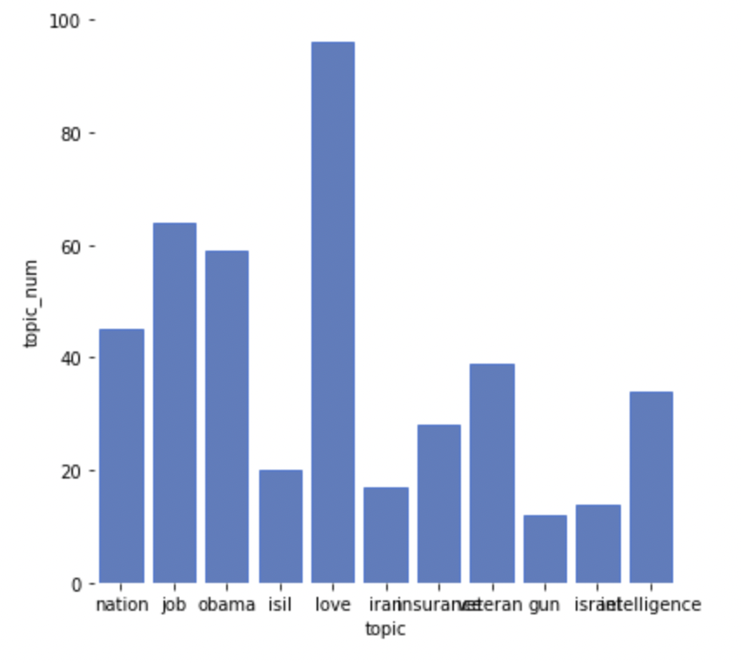
Count Topic
Result of NMF
Notes:
After sorting out the topic, I calculated the number of speeches contained in each topic based on the results of nmf. From the graph, we can see that Obama most often discusses the topic of love of family and child education since it contains most speeches, followed by topic2 is the second largest topic, contains words {engery, job, tax, deflict, economy} Then topic 1 and topic 3 are also quite popular during his presidential years, which are about nation and democracy, and obama second presidential year respectively.
Next i will discuss the external factors corresponds to the topic we have.

Slide 18
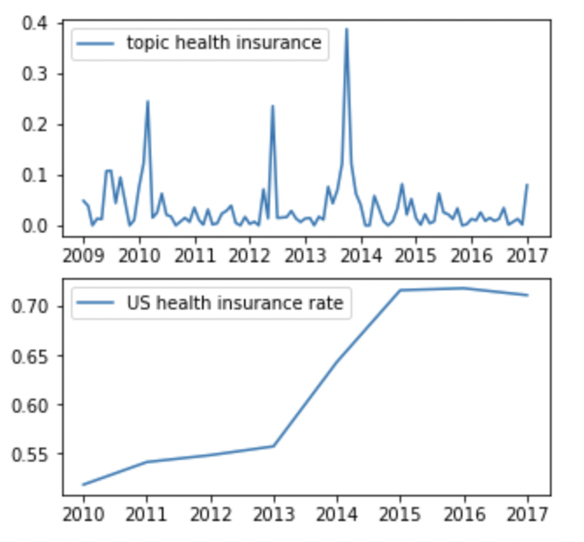
Health Care
Important events happened between 2011-2013:
Health Care Reform Bill
Affordable Care Act
Obama's speech had a significant influence on promoting health care in the United States, which was fairly reasonable given that health care was his major political accomplishment.
Notes:
Obama has always been concerned about health care issues during his presidential terms. By searching the information online, I learned that Obama proposed two major acts from 2011 to 2013: the health care reform bill and the affordable care act. Comparing the two graphs on the right, we can easily see that in 2010, when he started talking about the issue of health care, and the rate of health insurance coverage in the United States was rising steadily. Between 2012 and 2014, after Obama began giving several speeches and implementing his proposals, the health insurance coverage rate rose significantly from 2013 onward. Thus we can conclude Health care is one of the external factors.

Slide 19
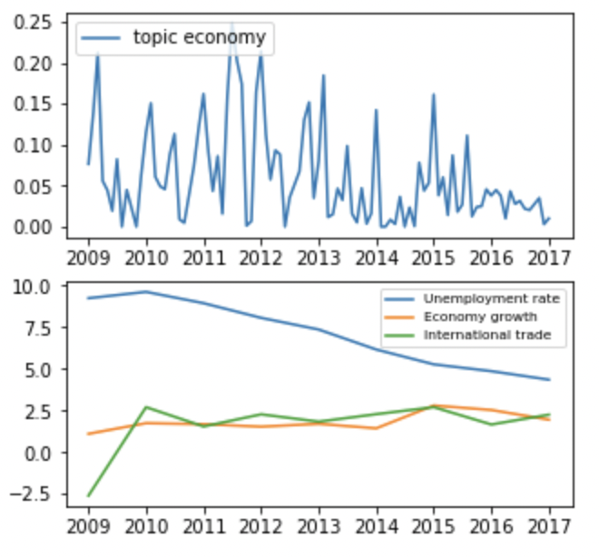
Economy and Employment
Important events happened between 2009 - 2012:
American Recovery and Reinvestment
American Job Act
Another of Obama's accomplishments is to the U.S. economy and jobs. As a result of his proposals and speeches, the unemployment rate has greatly decreased, and the country's economy and global trade have slowly increased.
Notes:
The second topic I want to discuss is about the economy and employment. We can see in the chart above right that Obama frequently mentioned the economy and employment between 2009 and 2012. Between 2009 and 2012, Obama proposed and implemented several actions, the main acts are American Recovery and Reinvestment, american job act. As we can see in the bottom right graph, since the implementation of these proposals, the unemployment rate has been decreasing. The rate of economic growth increased， but relatively flat, also the number of U.S. international trade transactions has increased significantly between 2009 and 2010.

Slide 20
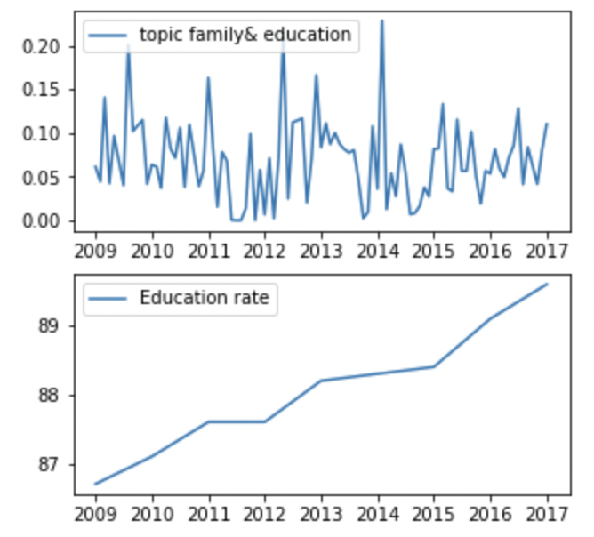
Education
Important events happened between 2009-2014:
Veteran education reform
No child left behind law
Children in America now have more access to school, and the advancement of American education has been accelerated by Obama's remarks and actions to bring about official education reform.
Notes:
The third topic I want to discuss is about education reform. We can see in the top right graph that between 2009 and 2014 Obama gave frequent speeches related to children's families and education. Between 2009 and 2014, Obama implemented a number of programs to improve education, the most important of which were the Veteran education reform and the no child left behind law. As you can see in the bottom right graph, since the implementation of these proposals, the education rate in the United States has been increasing linearly. Children in America now have more access to school, and the advancement of American education has been accelerated by Obama's remarks and actions to bring about official education reform.

Slide 21
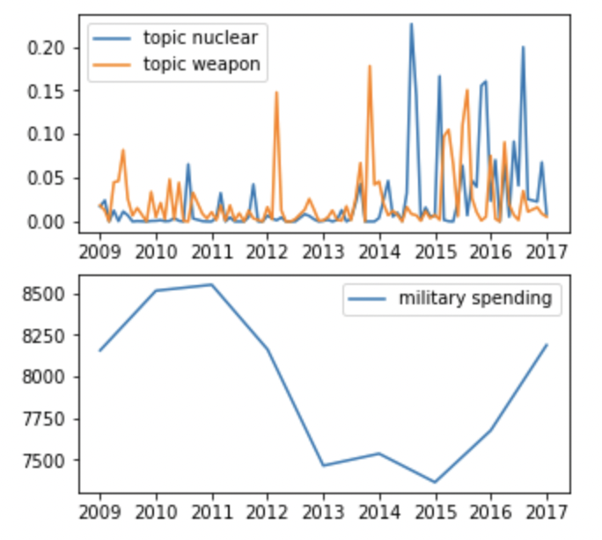
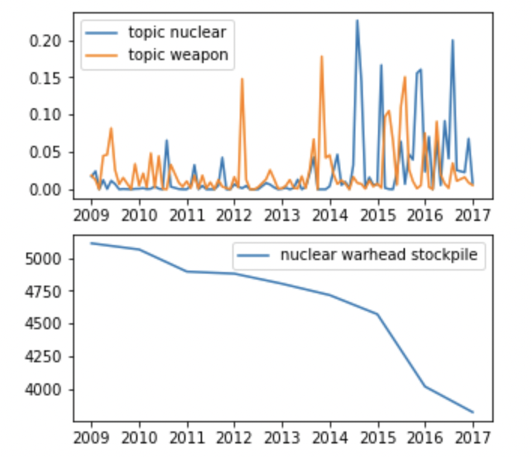
Military Spending
Notes:
The topic I want to discuss here is about nuclear security and the war. We can see the top 2 plots show that during From 2009 Obama offered the idea of a nuclear-free world. In 2012, 2014-2017, Obama spoke a lot about nuclear security, counter terrorism, and promoting peace and lessing war. Obama's statements have undoubtedly had a big impact on t Obama's statements have undoubtedly had a big impact on the military and nuclear security of the US.
Thus we can conclude Education, Health care, Military and nuclear war, economy and job opportunities are the main external factors for Obama’s speeches.

Slide 22
Conclusion

Slide 23
Summary
Data preparation: BeautifulSoup, and NLTK
Topic Modelling: Gensim LDA, Sk-Learn LDA, K-Means, and NMF
Sentimental Analysis: Textblob, and SentimentIntensitAnalyzer
428 Obama speeches can be classified into approximately 9 clusters
Most of his speeches are about democracy, economy, health care
Obama’s speeches are more positive
External Factors: Military costs and Nuclear safety, Education, Economy and employment, and health care.
Notes:
Here is the conclusion of my entire analysis procedure.
First I did data preparation using beautiful soup to fetch the data, and applied NLTK to clean the data
Then I used 4 methods: gensim, sk-learn, k-means and NMF to generate the topic modelling results.
In sentiment analysis, i used textblob and sentiment intensit analyzer to compute the polarity and determine the sentiment for speeches.
After the process is done, 428 speeches are classified into 9 topics, most of his speeches are related to democracy, economy, health care education and military.
The sentiment of overall speeches and topics are more positive, and the external factors corresponds to the speeches are military cost and nuclear safe idea, the education reform, the economy reform action, also the health care propsals.

Slide 24
Thanks for listening

